Slide 1
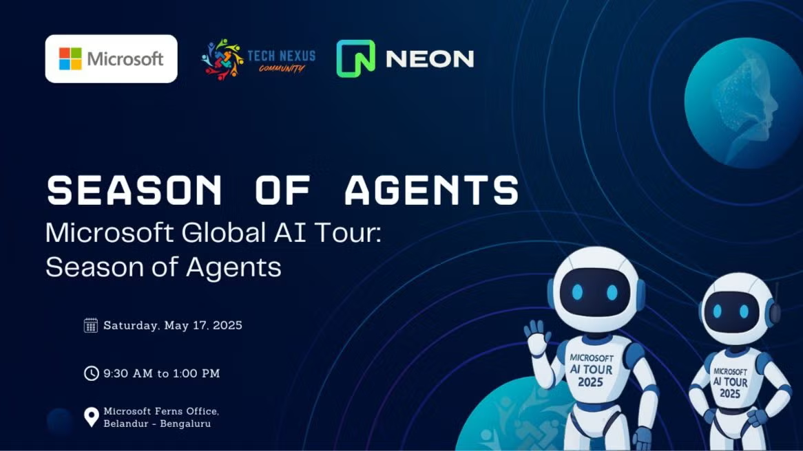

Slide 2

bit.ly/prateektalks
The Data Behind the Decision
Architecting Agent Memory
and Context on Azure

Slide 3


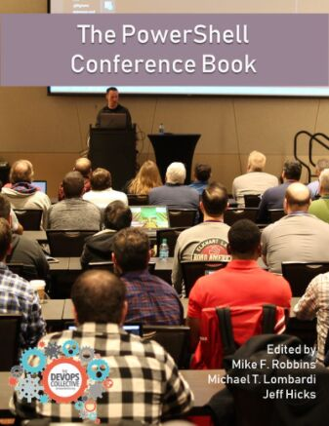
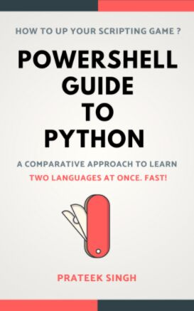







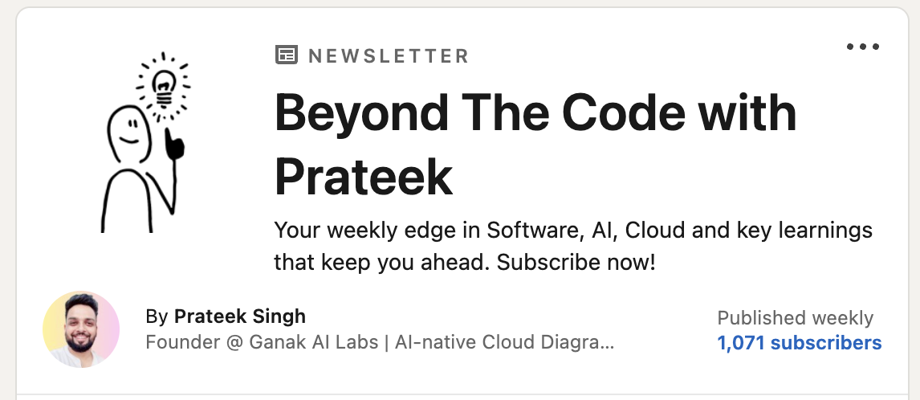
Books
Articles
Prateek Singh
Founder @ ganak.ai
Ex-Staff SWE Linkedin
Course
Linkedin Newsletter

Slide 4
Agenda
bit.ly/prateektalks
Importance of Memory
Types of Memory
Azure Memory/Context Providers
Azure Cosmos DB Unified AI database
Azure AI search vs Cosmos DB
Memory in Action
Primer - Semantic Cache, RAG
Patterns and Strategies
Demo - Movie Agent with Memory and Vector Search in Azure Cosmos DB
Takeaways
References

Slide 5
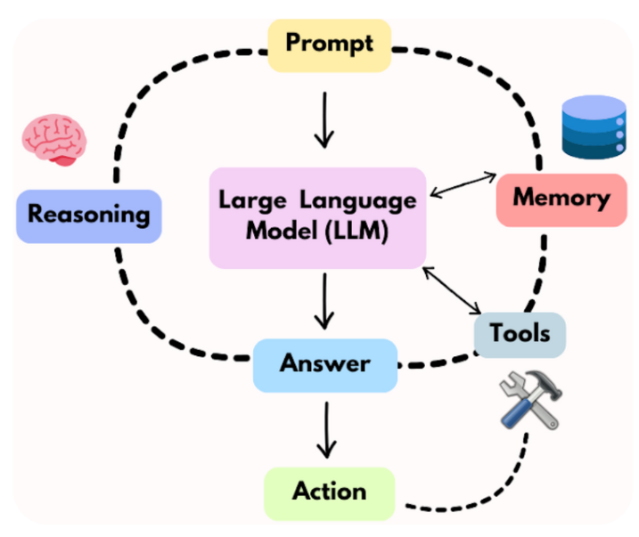

bit.ly/prateektalks
Importance of Memory in Agentic Systems
LLMs are Stateless 🧠
Forget everything between prompts
No continuity without memory
Agents are Autonomous 🤖
Autonomy requires decision-making
Decision-making depends on context
Reasoning needs Memory 🧩
Recall of past interactions (tool use, user input)
Recall of past behaviors (plans, decisions)
Efficiency is Key ⚙️
Fast, relevant retrieval is critical
Too much data slows performance
Why Memory Matters 🌱
Enables Continuity
Drives Personalization
Supports Long-Term Learning

Slide 6
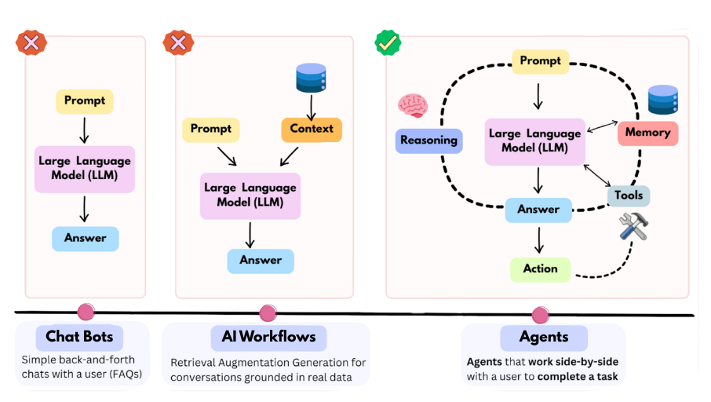
bit.ly/prateektalks
Importance of Memory in Agentic Systems
LOW AUTONOMY
HIGH AUTONOMY
None
Requires external control
Low Predefined steps
High Self-directed

Slide 7
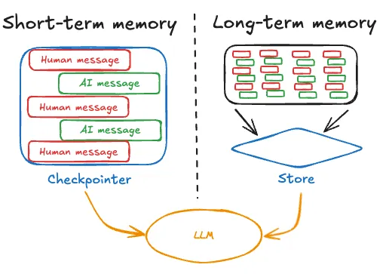
AI Agents Memory Types
Foundation of Intelligent Agents
bit.ly/prateektalks
Short-Term Memory | Long-Term Memory
Lives during one session (Ephemeral) | Persists across sessions
Fast access, limited capacity | Slower access, high capacity
Stores current conversation context | Stores knowledge, preferences, history
In-memory (RAM, context window) | Vector DBs, knowledge bases (e.g. RAG)
Reset after each interaction | Enables personalization, learning
Great for flow and coherence | Great for retention and reasoning

Slide 8
bit.ly/prateektalks
Azure DB or Azure AI Search?

Slide 9

Azure Cosmos DB Unified AI Database
bit.ly/prateektalks
Feature | Description
🌍 Global Distribution | Replicate data across any Azure region
⚡ Low Latency & High Throughput | <10 ms reads, <15 ms writes at 99th percentile
🔁 Multi-Model Support | Document, key-value, graph, column-family models
🧠 AI-Ready Vector Search | Native support for vector similarity queries (Semantic search)
📈 Elastic Scalability | Instantly scale throughput & storage – per container or database
🔐 Enterprise-Grade Security | Encryption at rest, RBAC, private endpoints, compliance (ISO, HIPAA, etc.)
What?
A Globally Distributed NoSQL database
Designed for fast and scalable applications
Supports multiple APIs: SQL (Core), MongoDB, Cassandra, Gremlin, Table
Use Cases
Real-time personalization and recommendations
IoT telemetry ingestion
Retail catalog and inventory management
Chat memory (Long term)
Context store in AI agents

Slide 10
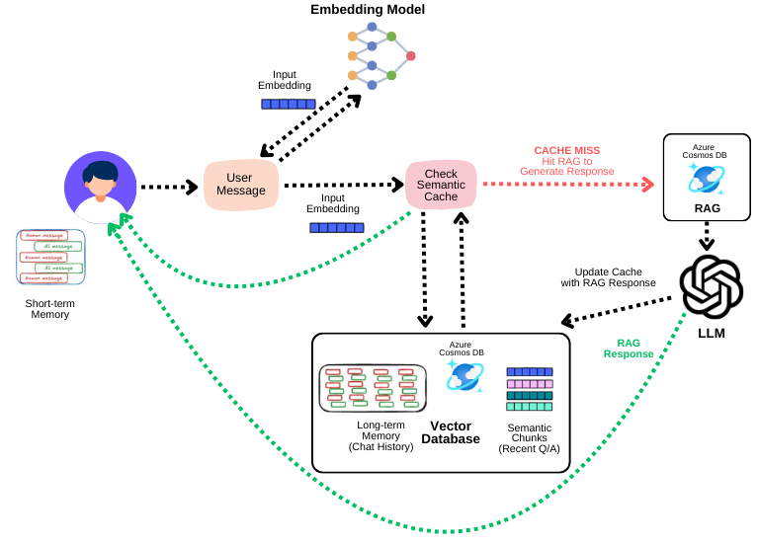
Memory in Action
How Agents Use Memory in Practice
bit.ly/prateektalks
What’s Stored?
Conversation history
User preferences
Tool usage and past actions
Semantic chunks

Slide 11
bit.ly/prateektalks
Demo
Movie Agent with Memory
& Vector Search in Azure Cosmos DB

Slide 12
Takeaways
bit.ly/prateektalks
“ Smart agents aren’t just built on models. They’re powered by what they remember. ”
LLMs are stateless by default Agents need external memory to reason, adapt, and evolve over time.
Short-term and long-term memory work together Use short-term for conversational context, long-term for persistent learning and personalization.
Memory types are layered, not isolated Context window → Semantic cache → RAG/external knowledge = powerful hybrid recall.
Vector search unlocks semantic recall Azure Cosmos DB and Azure AI Search enable scalable, fast retrieval beyond keyword match.
Data design = agent performance Structure, filter, and summarize memory well to balance accuracy and efficiency.

Slide 13
References
bit.ly/prateektalks
What is the database behind ChatGPT?
Azure Cosmos DB Vector Search & DiskANN Vector
Unified AI Database - Azure Cosmos DB | Microsoft Learn

Slide 14

Thank you &
Let’s keep the conversation going!
bit.ly/prateektalks
Connect with me on LinkedIn I share insights on AI, Cloud, and Software Engineering.

